Slide 1
UQ SchoolsNet - Future Ready with AI (July 2026)
Practical AI: Choose your Adventure
Dr Aneesha Bakharia
Senior Lecturer, EECS, UQ
Email: a.bakharia1@uq.edu.au

Slide 2
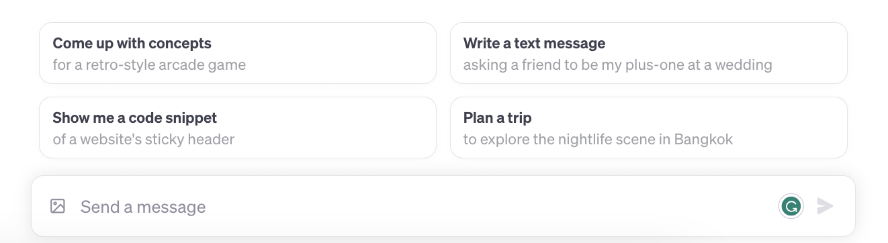
A new human computer interface
OpenAI ChatGPT was released on 30 Nov 2022
A prompt is a piece of text that triggers
a specific response or action

Slide 3

Rarely has a technology possessed such profound potential to both revolutionize and challenge the boundaries of education
Answer questions
Feedback on writing
Feedback on programming
Brainstorm new ideas
Personalised Chatbot tutors/mentors
Provide direct answers across multiple domains
Write essays for you
Write programming code for you
Perform data analysis

Slide 4
Initial Flaws Identified by Educators
3.5 years since the first initial release and already most are not valid …
Can’t take feedback
Can’t reflect
Can’t do math
I’ll be able to detect it
The text will have false facts
Can't understand images
Can't include references
Can't reason

Slide 5
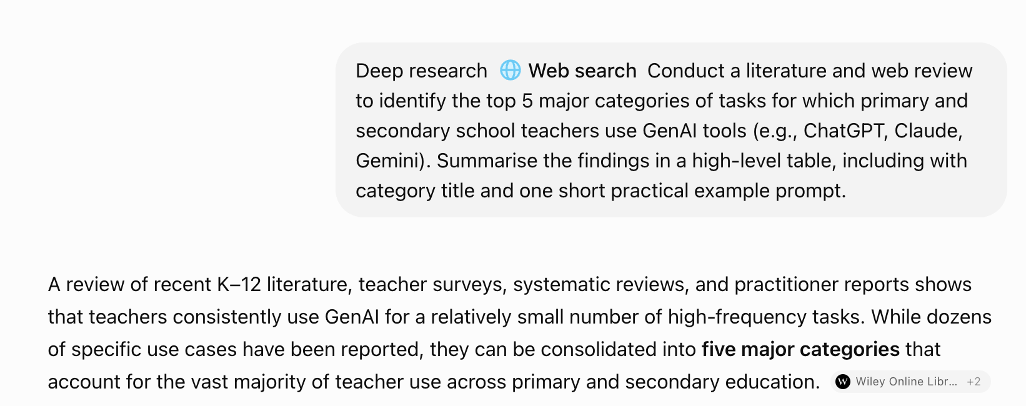
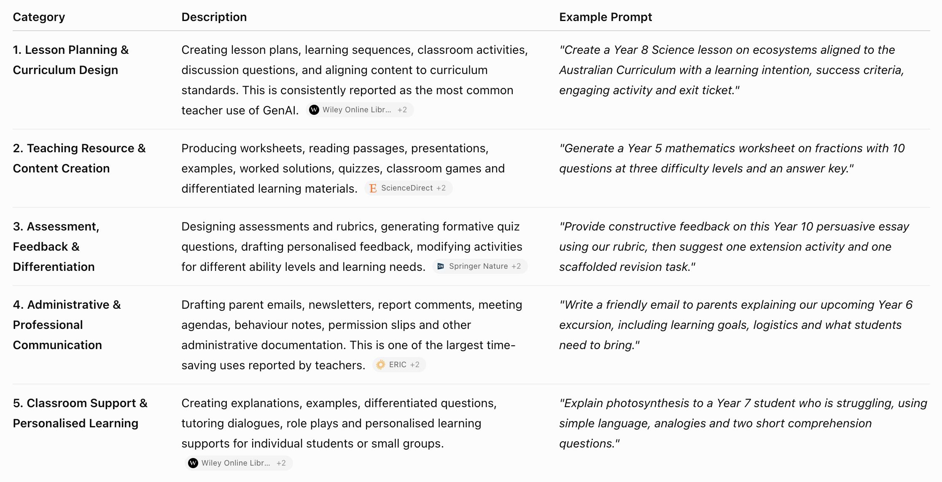
Current LLM Prompts for Teachers

Slide 6
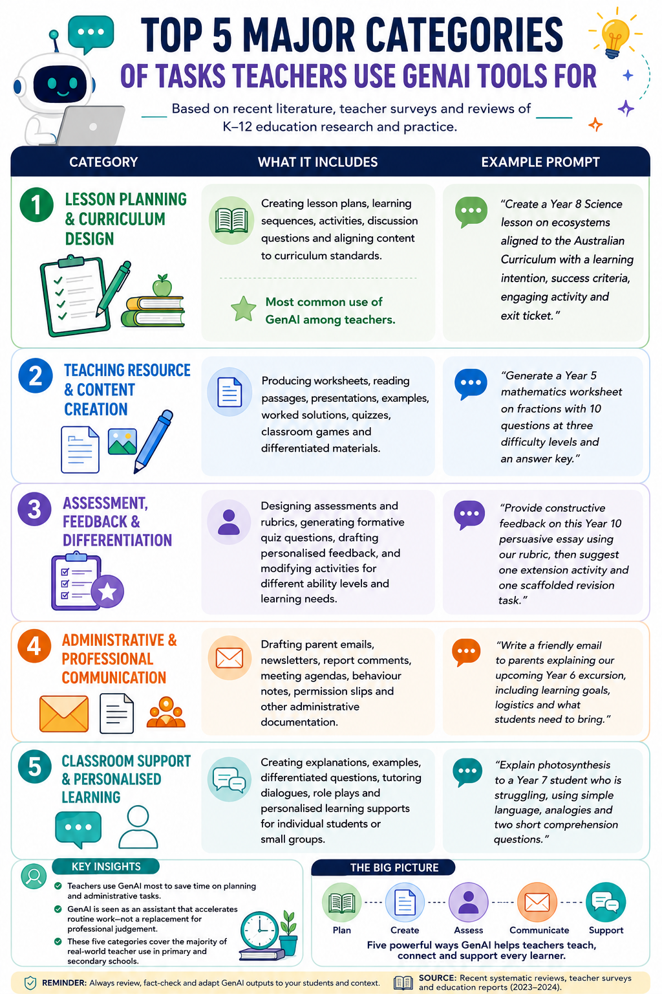

Current LLM Prompts for Teachers

Slide 7
“Challenge what you can create…
“Challenge your thinking of learning with AI…
Text instructions are all you need

Slide 8
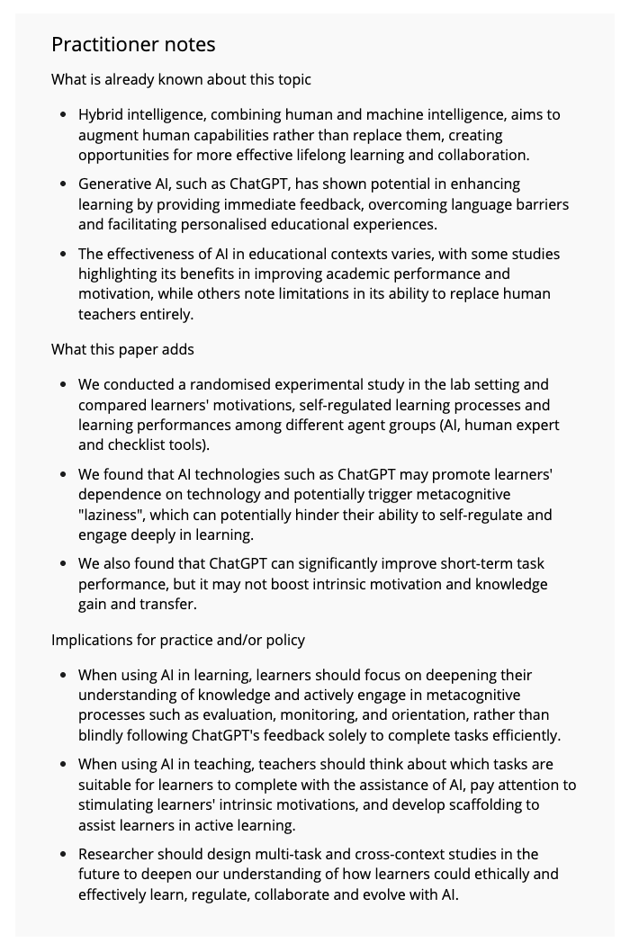
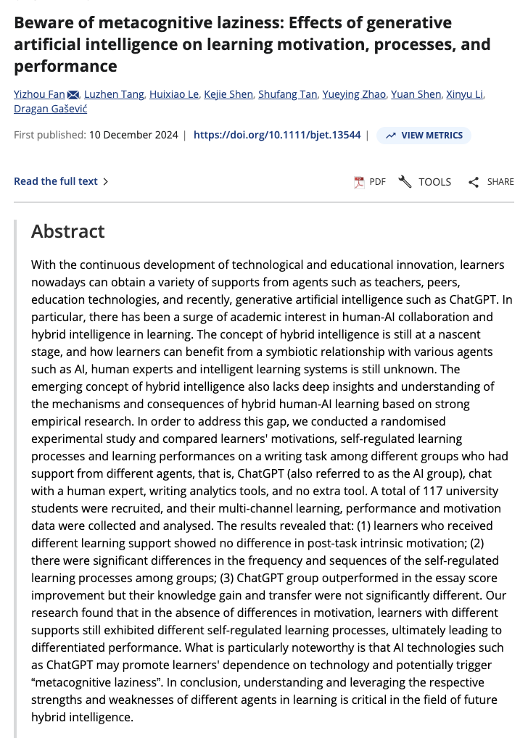
Metacognitive Laziness
https://bera-journals.onlinelibrary.wiley.com/doi/10.1111/bjet.13544

Slide 9
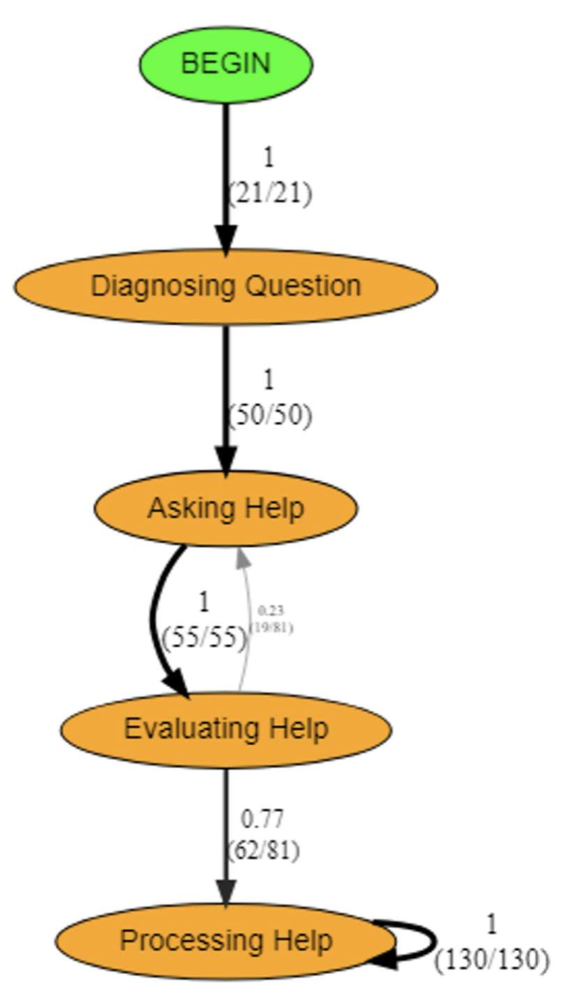
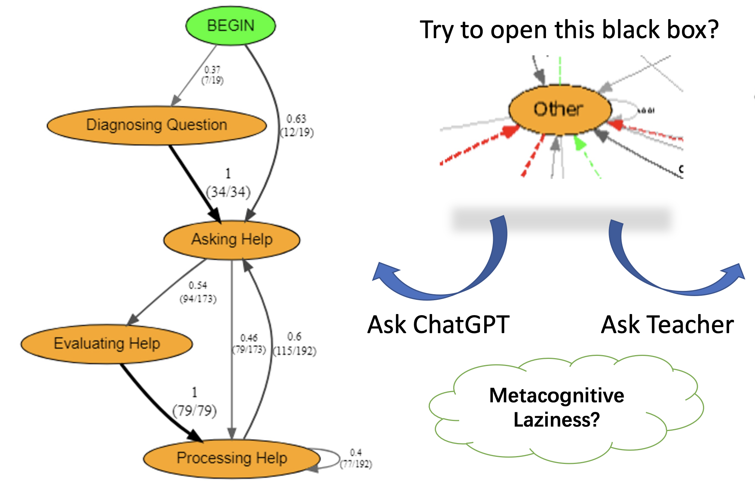
Comparing Help Seeking Processes
Chen, A., Xiang, M., Zhou, J., Jia, J., Shang, J., Li, X., ... & Fan, Y. (2025). Unpacking help-seeking process through multimodal learning analytics: A comparative study of ChatGPT vs Human expert. Computers & education, 226, 105198.

Slide 10
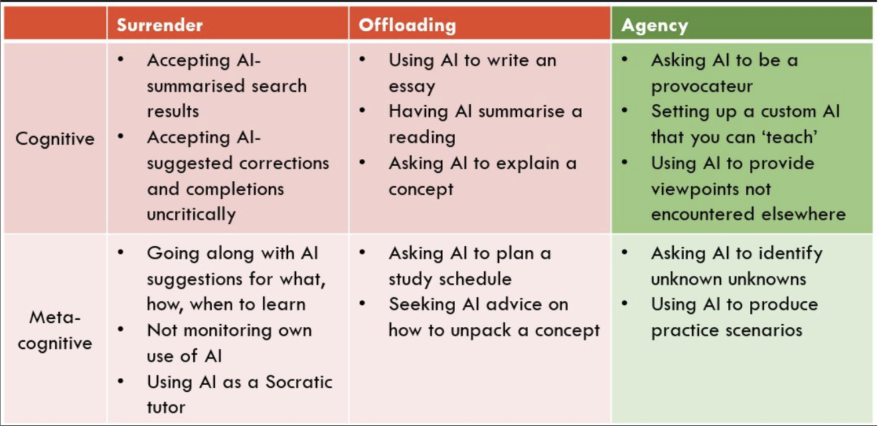
Cognitive Offloading to Cognitive Surrender
“A few recent articles have been exercising me lately, around cognitive and metacognitive offloading and 'surrender'. In preparing for an upcoming talk, I've been trying to think about what this looks like on the ground in classrooms and elsewhere.”
Danny Lui’s LinkedIn Post
https://www.linkedin.com/posts/dannydotliu_ai-education-teaching-activity-7450757129696616448-fPkd

Slide 11
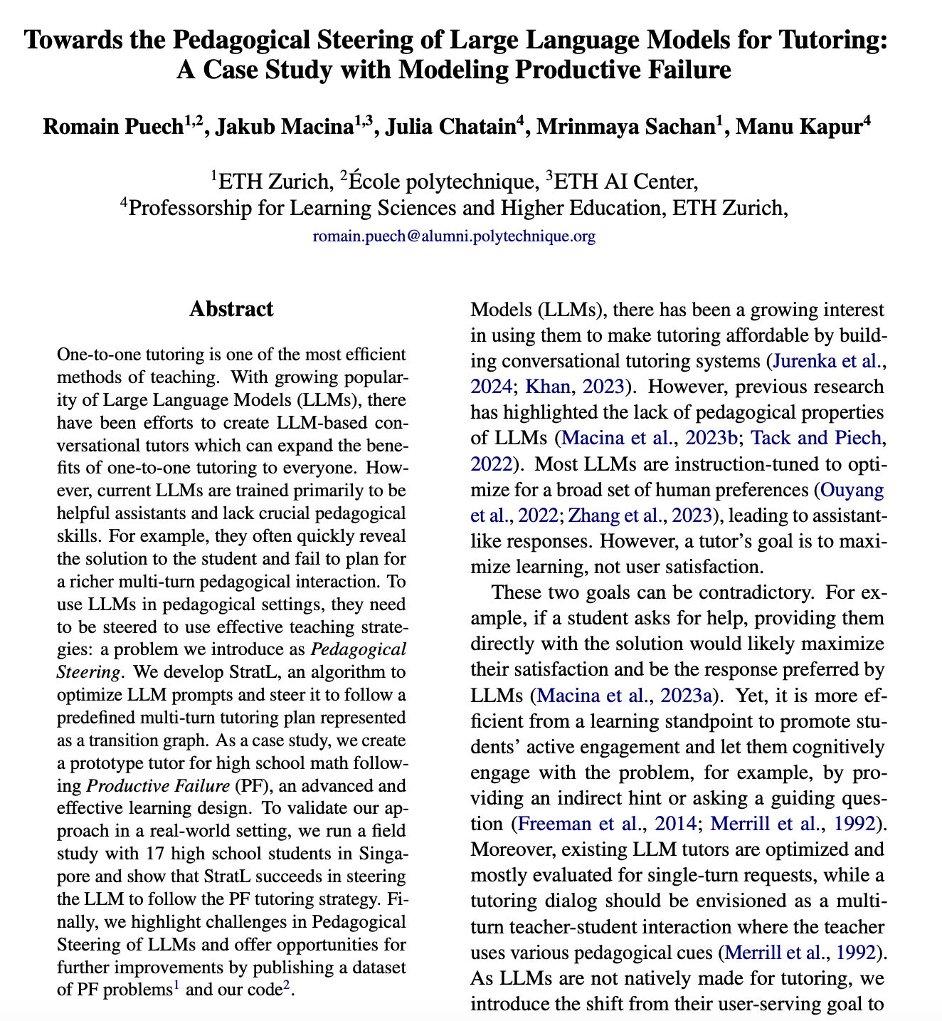
Productive Failure – The missing element?
https://aclanthology.org/2025.findings-acl.1348.pdf

Slide 12
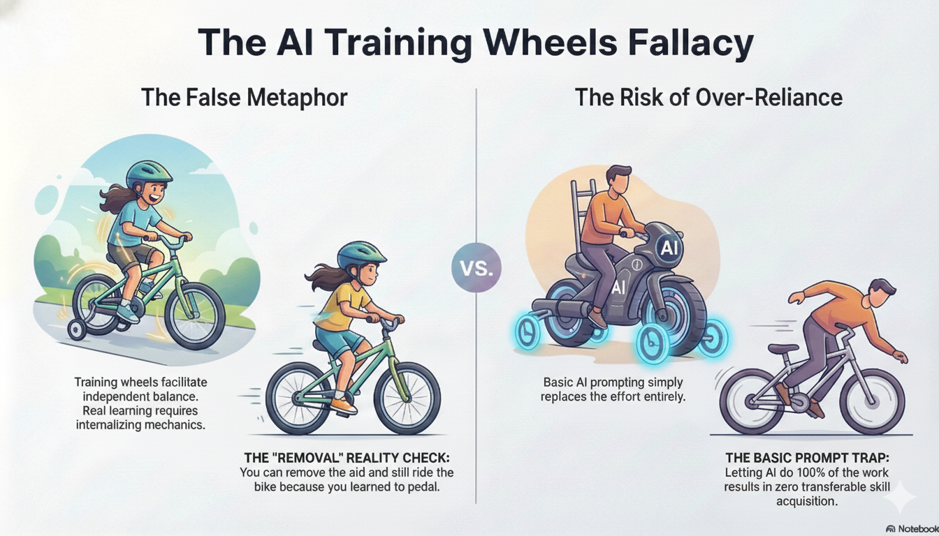

Slide 13
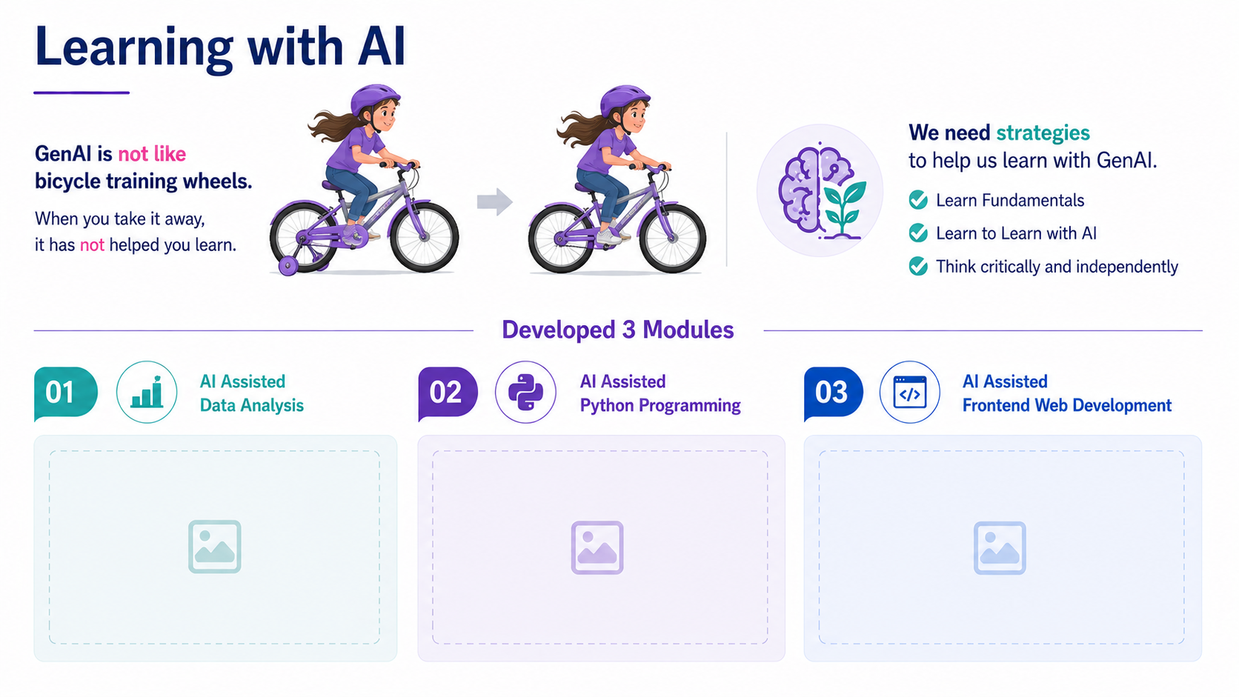
Learning to Learn with GenAI

Slide 14
Choose Your Adventure

Slide 15
Choose Your Adventure Labs
Lab 1: Learning Resources | Lab 2: Chatbot Tutors
Create Worksheets with Teacher Step by Step Solutions | Create a Pedagogical Moves Tutor
Build an Interactive Glossary | Create a Design Thinking/Brainstorming Tutor
Developing Student Evaluative Judgement | Create a Programming Tutor that helps build debugging and code reading skills
Build a Geometry Sailboat Game | Create an Offline Math Equation Intelligent Tutor
Go to: https://prompting.uqcloud.net

Slide 16
Why Learning to Learn with GenAI Matters?

Slide 17
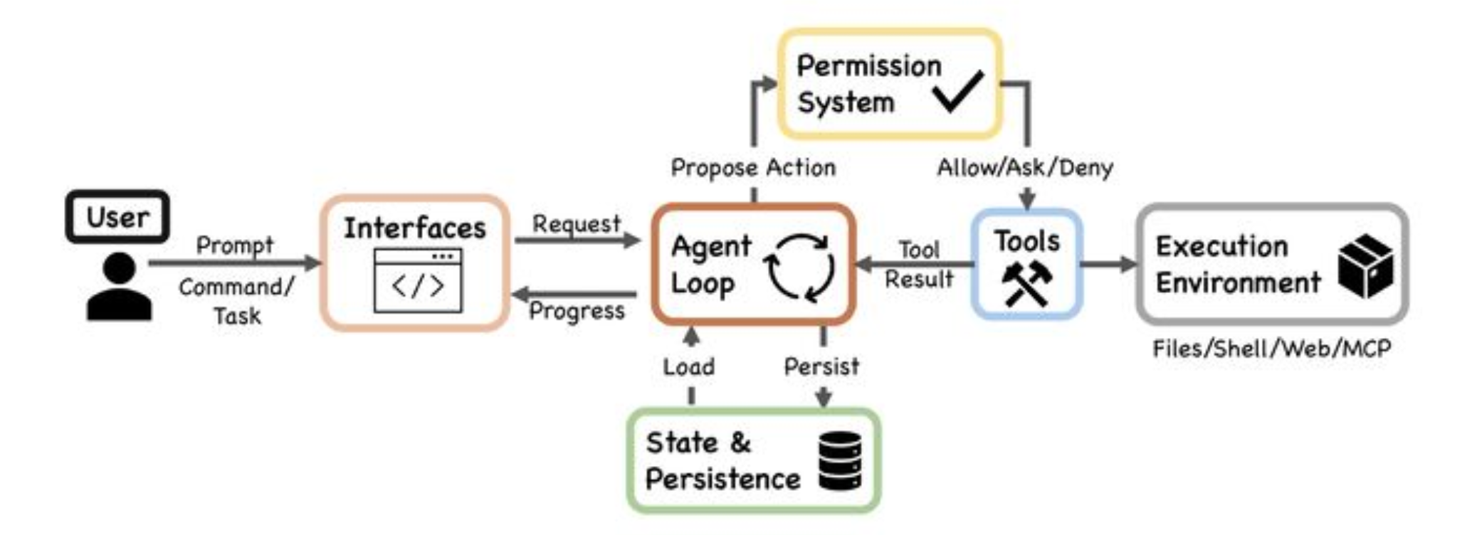
The Agentic Harness
  Plan
  Spawn agents
  Supports longer running tasks
  Setup coding environments
  Execute
  Review and fix
  Write tests and test the UI in the browser
  Go from high level idea to working product/artefact
  Much more (whole computer access)
  Can run with little human input
  Tools:
  Claude Code; Open AI Codex; Google Antigravity; Claude Cowork (for knowledge workers)
https://www.linkedin.com/posts/charlesmartin14_dive-into-claude-code-a-comprehensive-overview-activity-7451489099615731712-LIQh

Slide 18
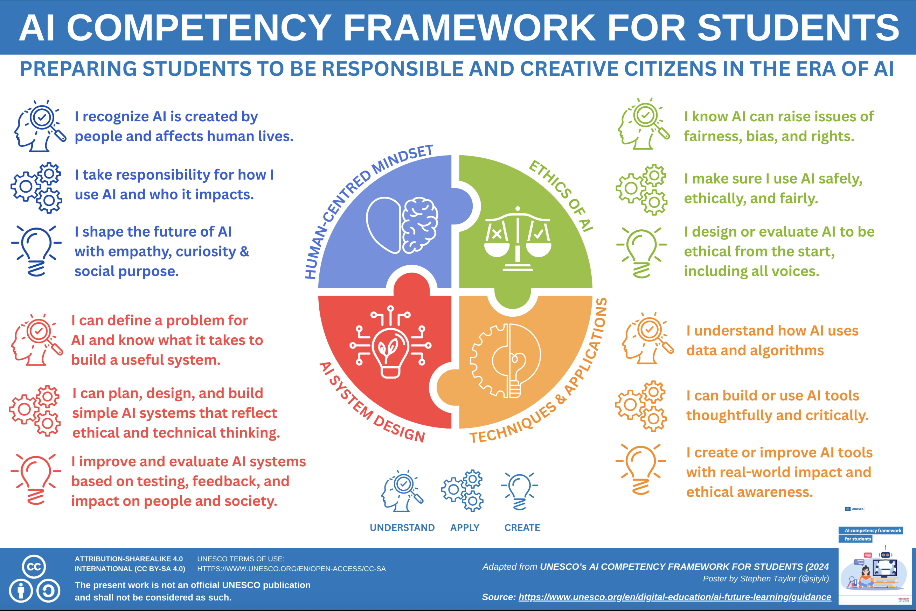

Slide 19
Thank you

