Slide 1
UQ SchoolsNet - Engaging Minds in IT (Dec 2025)
Practical AI - Tools for Educators:
Choose your Adventure
Dr Aneesha Bakharia
Senior Lecturer, EECS, UQ
Principal Practitioner – AI in Education, ITaLI, UQ
Email: a.bakharia1@uq.edu.au

Slide 2
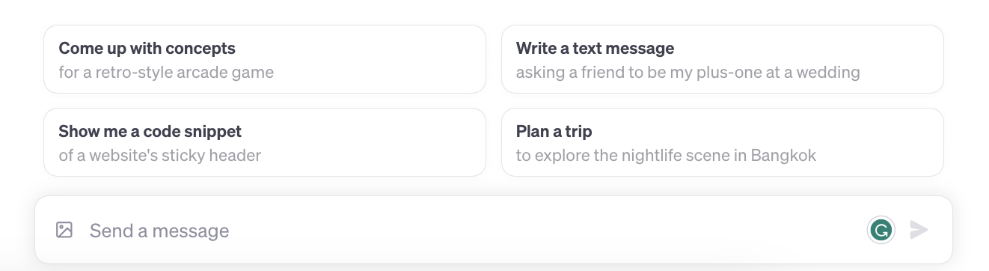
A new human computer interface
OpenAI ChatGPT was released on 30 Nov 2022
A prompt is a piece of text that triggers
a specific response or action

Slide 3

Rarely has a technology possessed such profound potential to both revolutionize and challenge the boundaries of education
Answer questions
Feedback on writing
Feedback on programming
Brainstorm new ideas
Personalised Chatbot tutors/mentors
Provide direct answers across multiple domains
Write essays for you
Write programming code for you
Perform data analysis

Slide 4
Initial Flaws Identified by Educators
3 years since the first initial release and already most are not valid …
Can’t take feedback
Can’t reflect
Can’t do math
I’ll be able to detect it
The text will have false facts
Can't understand images
Can't include references
Can't reason

Slide 5
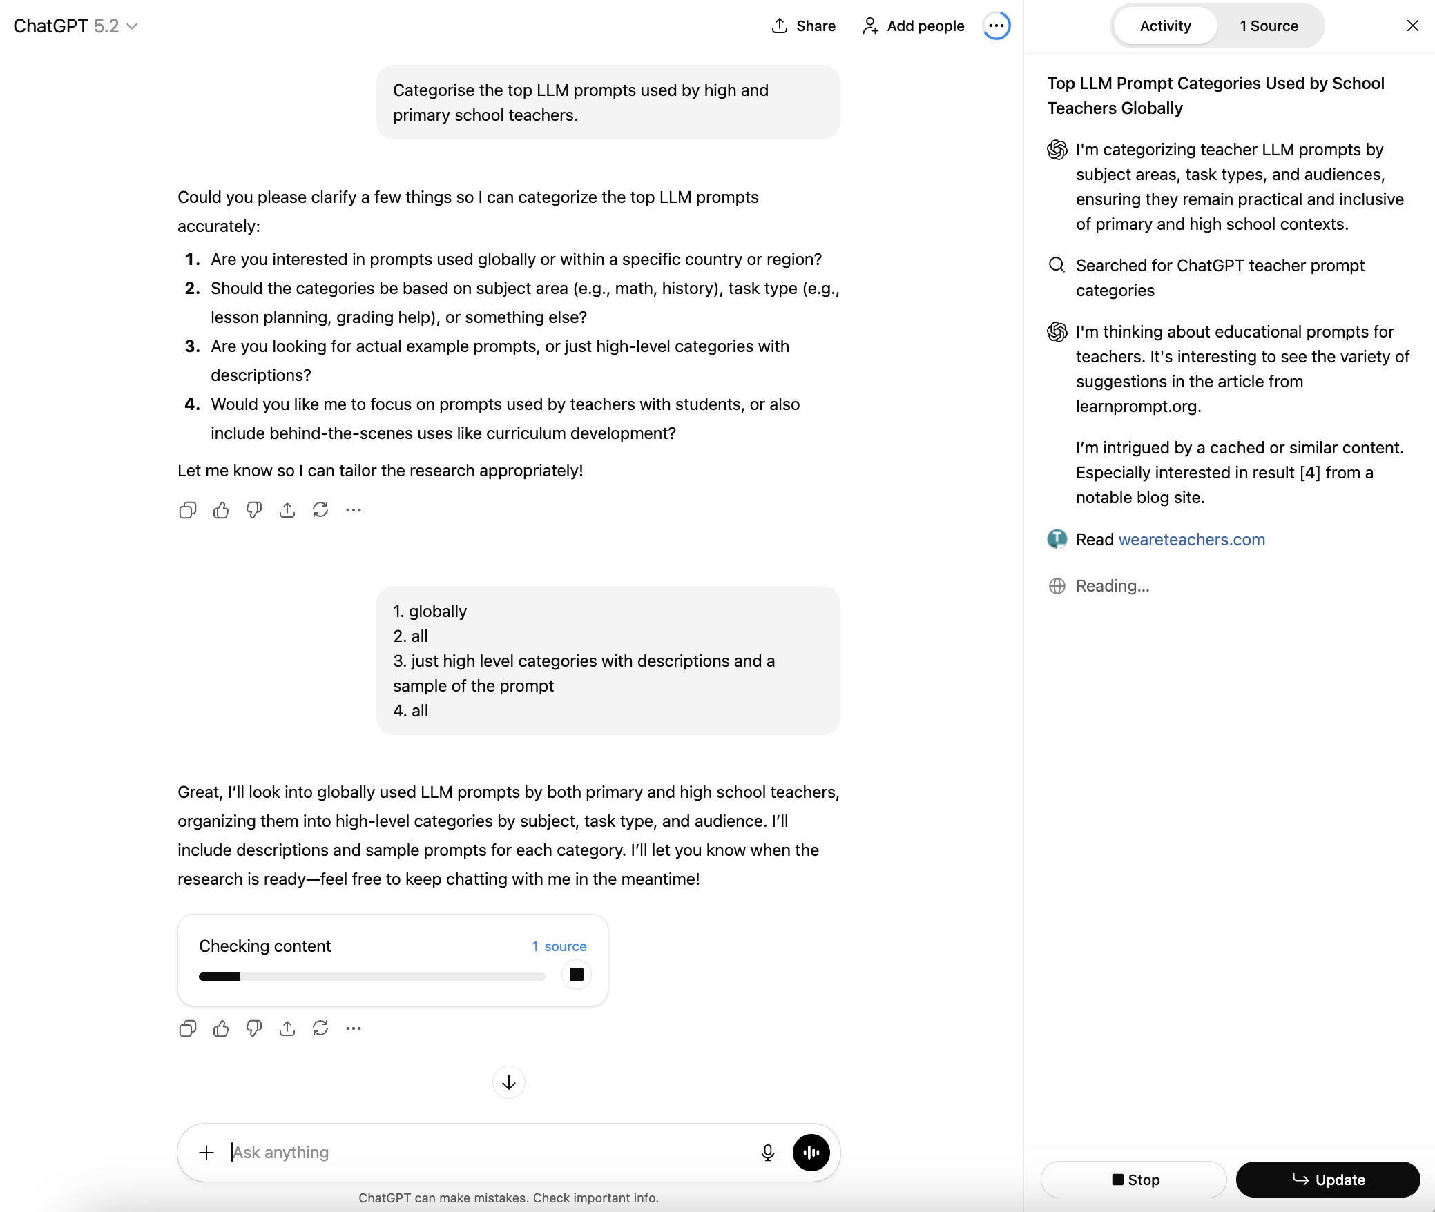
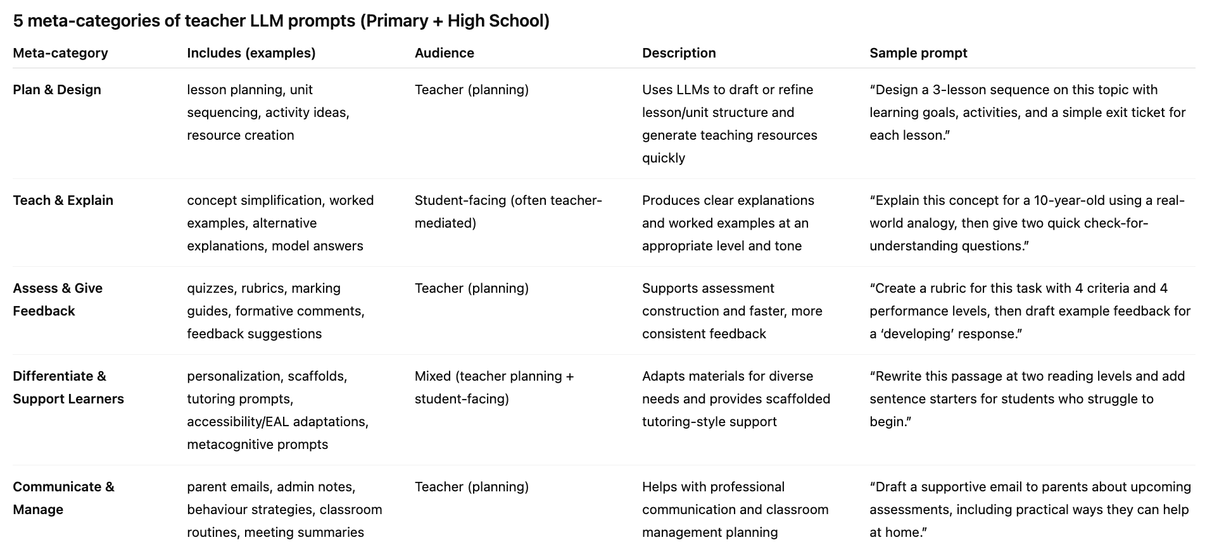
Current LLM Prompts for Teachers

Slide 6
My aim today is to
challenge
what you think is possible in
Education?
Text instructions are all you need

Slide 7
Example 1: Maths Worksheet Creator
Asks questions to get audience and topic
Uses Python code to do the calculations
Provides step by step teacher solutions
Provides either a MS Word or Latex version
Implemented as an Open AI Custom GPT
https://chat.openai.com/g/g-ZEXukr2ci-math-worksheet-creator

Slide 8
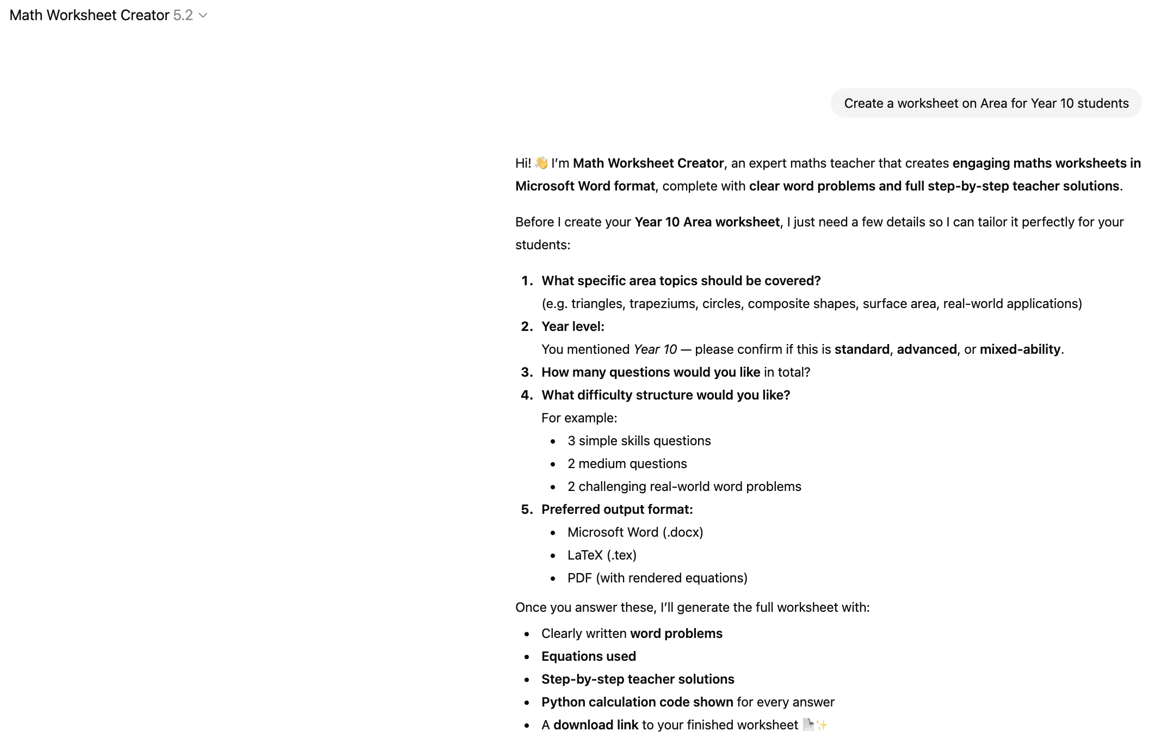
Example 1: Maths Worksheet Creator

Slide 9
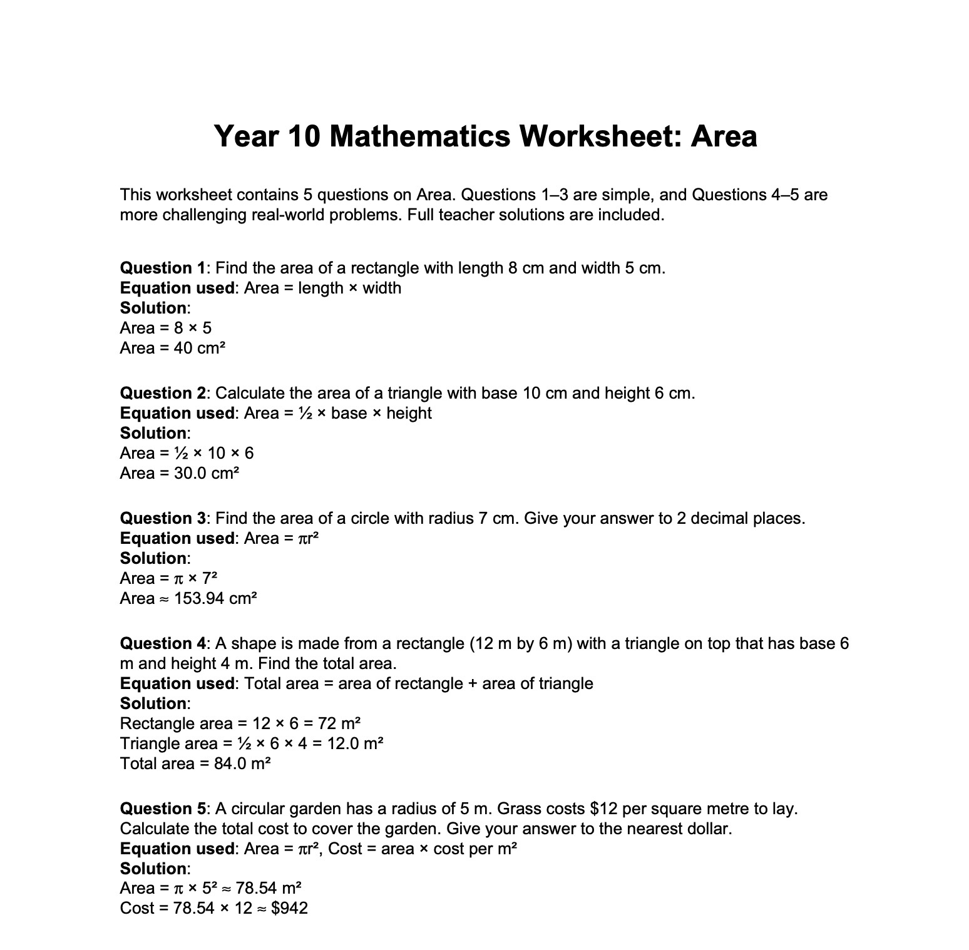
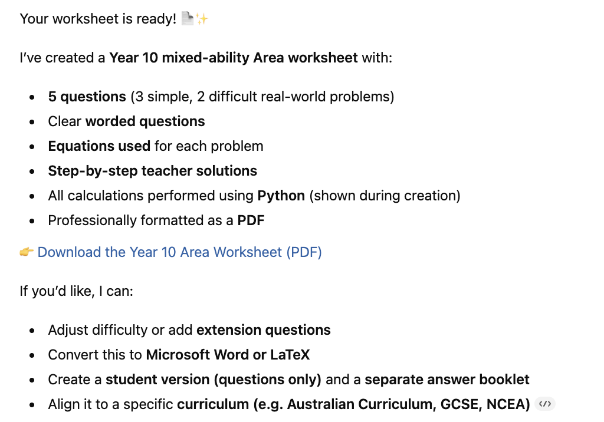
Example 1: Maths Worksheet Creator

Slide 10
Example 2: Pedagogical Moves Tutor
Pedagogical moves described with few shot examples
No finetuning and all done in a single prompt
Tutor for any topic
Does not directly give the answer
Implemented as an Open AI Custom GPT
Prompt can be re-used on other platforms
https://chat.openai.com/g/g-7DbChkwg7-guide-mind-every-subject-tutor

Slide 11
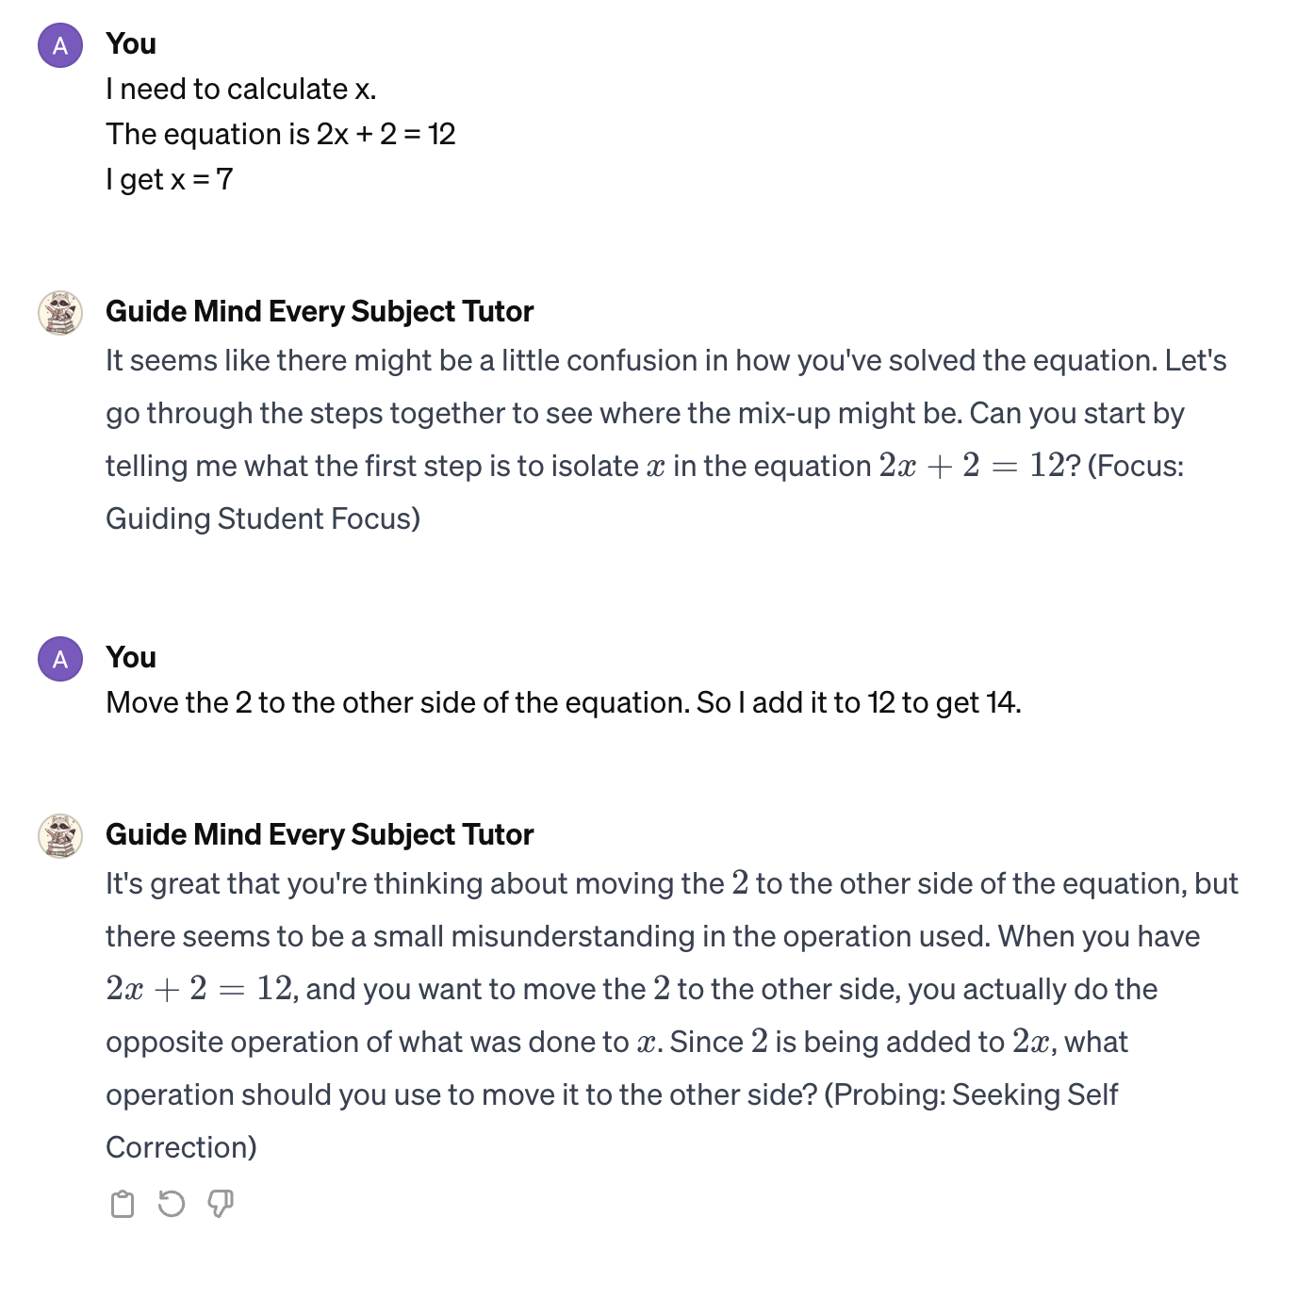
Example 2: Pedagogical Moves Tutor

Slide 12
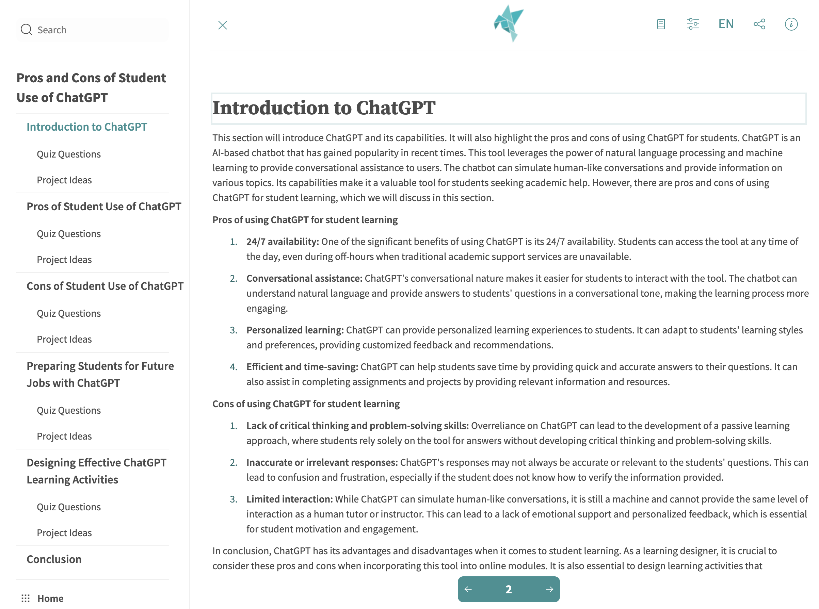
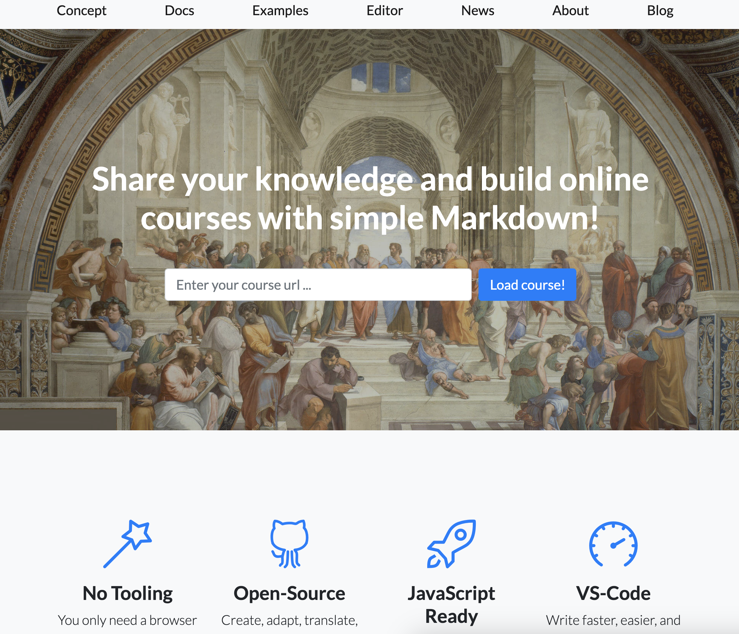
Example 3: Automated Course Generation
https://github.com/aneesha/eduweaver
https://liascript.github.io/

Slide 13
Eduweaver Prompts
Prompt: Generate Content
Could you please write the content for {section_name} that will be understood by {audience}?
The description of the topic that you must write is {section_description}.
{teaching_method_to_include_text}
{sub_topics_to_not_include_text}
Please don't output the section name but do include an introductory paragraph.
Prompt: Generate TOC
Please act as a subject matter expert on the topic of {topic} that also has learning designer skills and knowledge of markdown and json.
You know how to design online modules. You can break up the content into chunks, explain concepts so that can easily be understood, write quizzes to test knowledge and write creative learning activities for students.
Could you please come up with {no_sub_topics} sections for an online module on the topic of {topic} for {audience} in json format?
{sub_topics_to_include_text}
{sub_topics_to_not_include_text}
Here is an example of the format you need to return:
[{{"section_name": "The name of the section 1", "section_description": "The descriptions of the section 1"}}]
Please don't return any intro text before or after the json.
Prompt: Generate Quiz: Generate Quizzes
Could you please write quiz questions for the content in {section_name} that will be appropriate for {audience}?
The description of the topic that you must write quiz questions for is {section_description}.
Please write {no_quiz_questions_in_sub_topic} questions in the json format that is given in the example below.
[{{"question": "Question 1","question_type": "single_option","options": [{{"option_name": "Option 1", "correct": "false"}},
{{"option_name": "Option 2", "correct": "true"}}]
}}]
The incorrect answers should not be obvious or easy.
https://github.com/aneesha/eduweaver

Slide 14
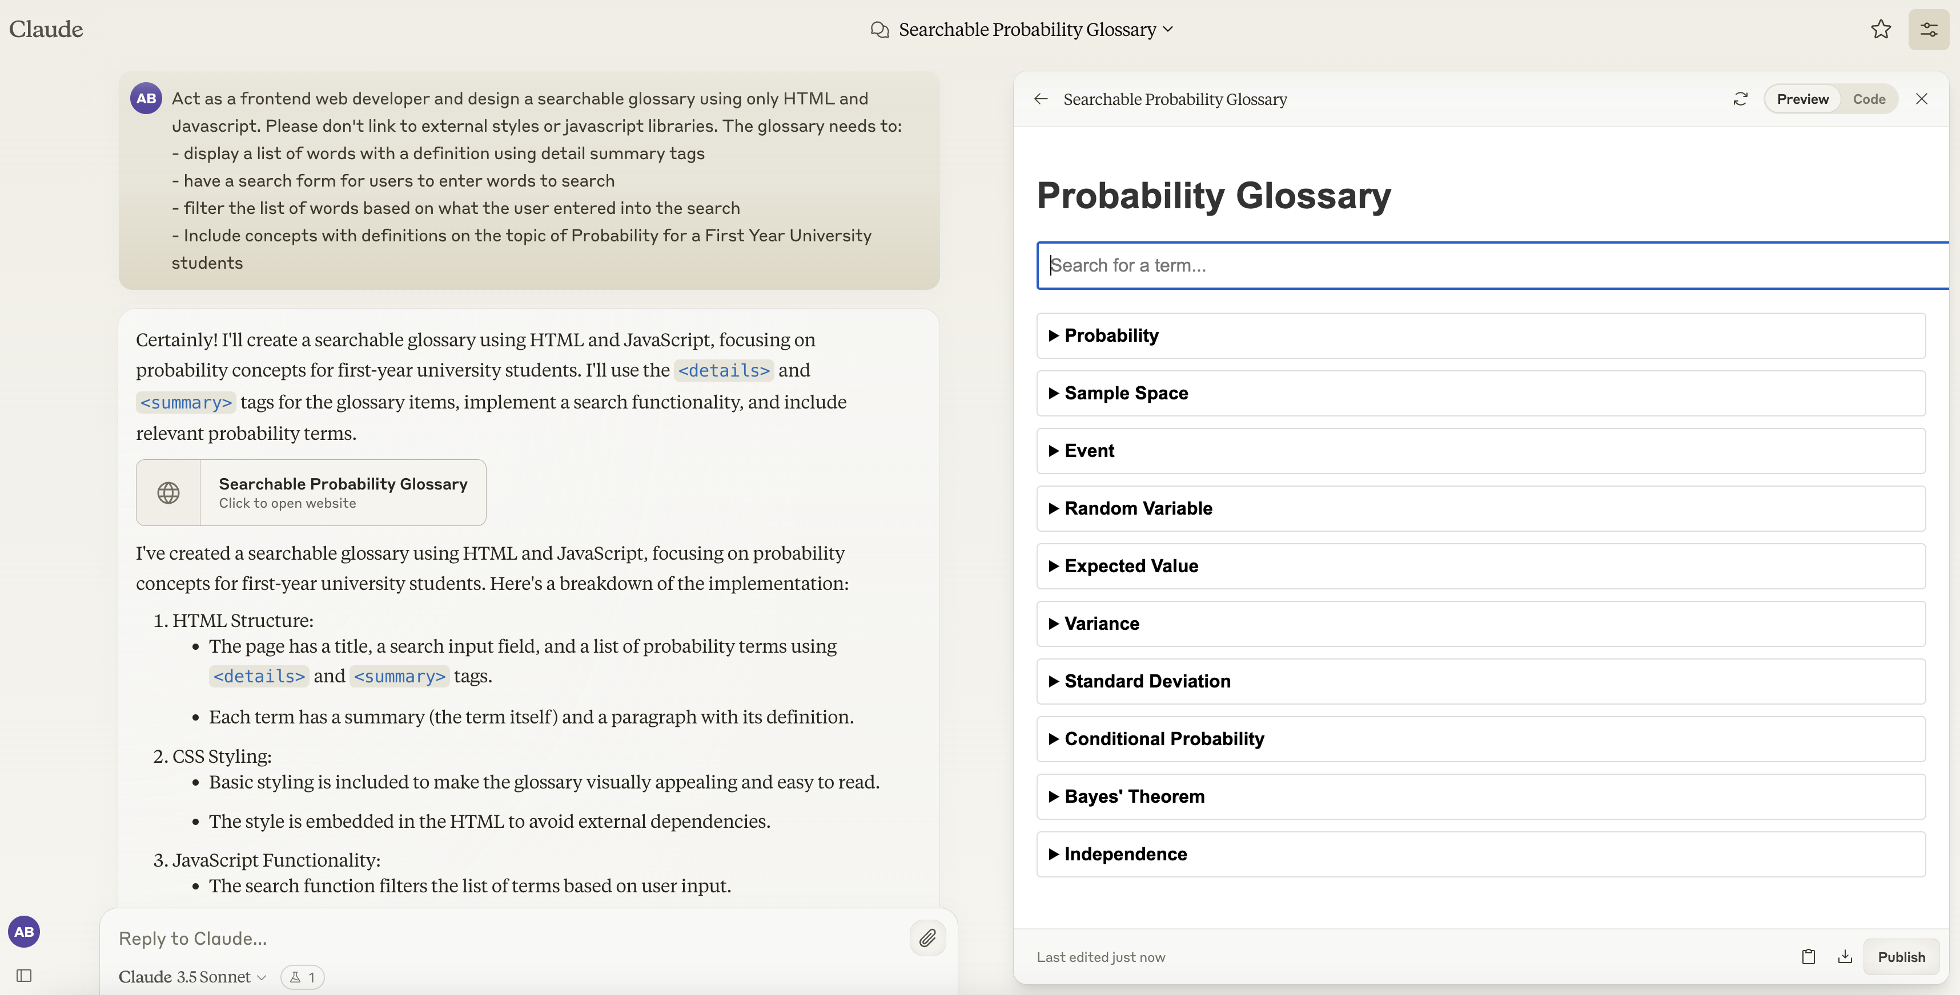
Example 4: Creating Learning Tools
https://claude.site/artifacts/064cf03e-988f-4bf0-8244-f9c5d891ca86

Slide 15
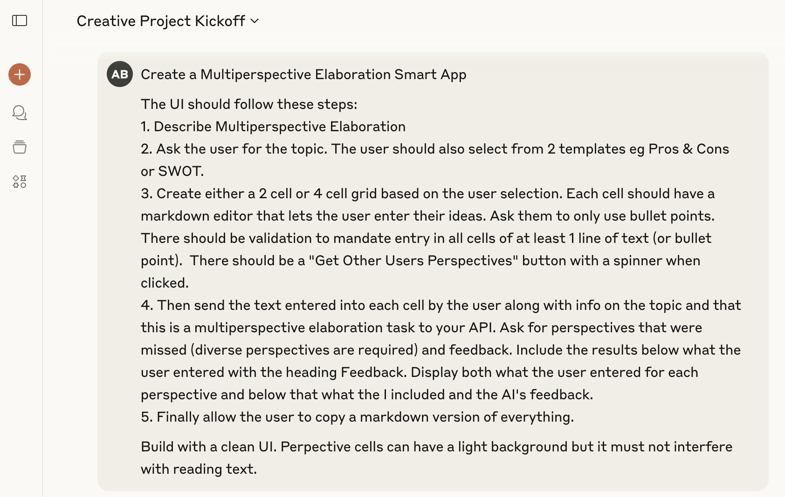
Example 5: Creating Smart Apps
Get Claude to call itself
https://claude.ai/public/artifacts/fc6fe239-52e0-4313-9900-f2d9130235d2

Slide 16
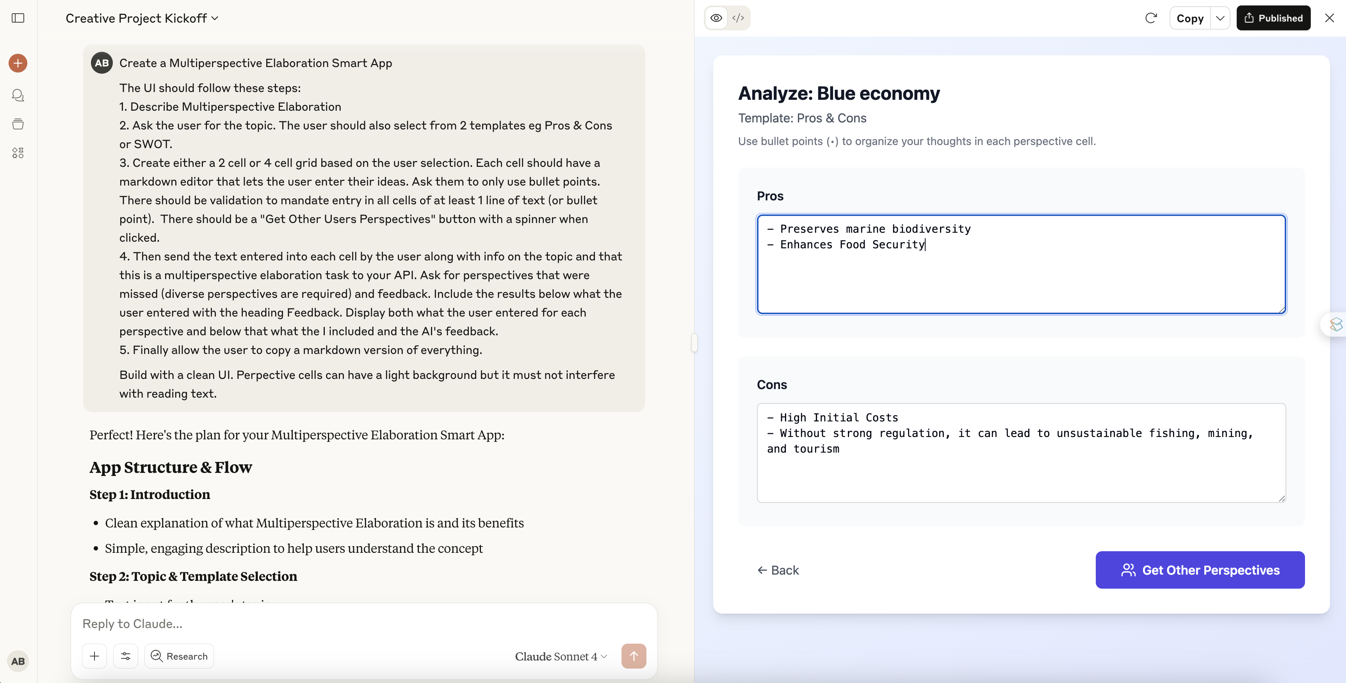
Example 5: Creating Smart Apps
https://claude.ai/public/artifacts/fc6fe239-52e0-4313-9900-f2d9130235d2

Slide 17
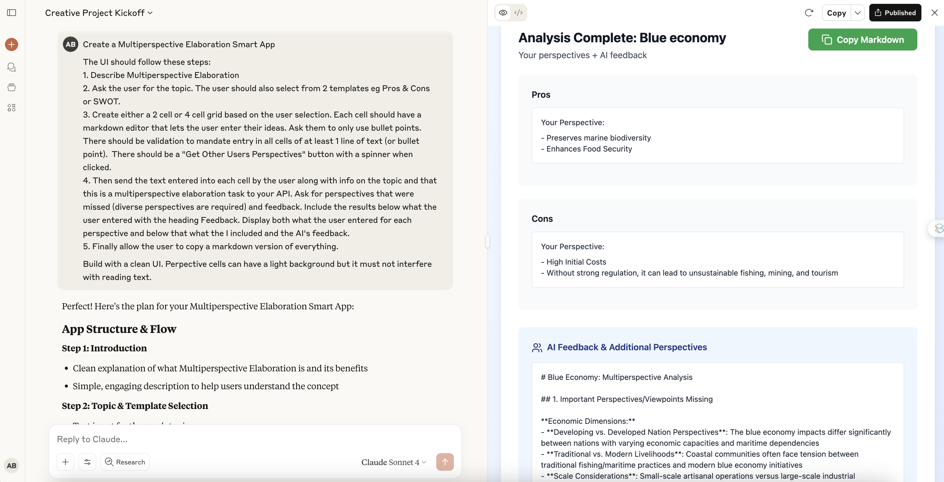
Example 5: Creating Smart Apps
https://claude.ai/public/artifacts/fc6fe239-52e0-4313-9900-f2d9130235d2

Slide 18
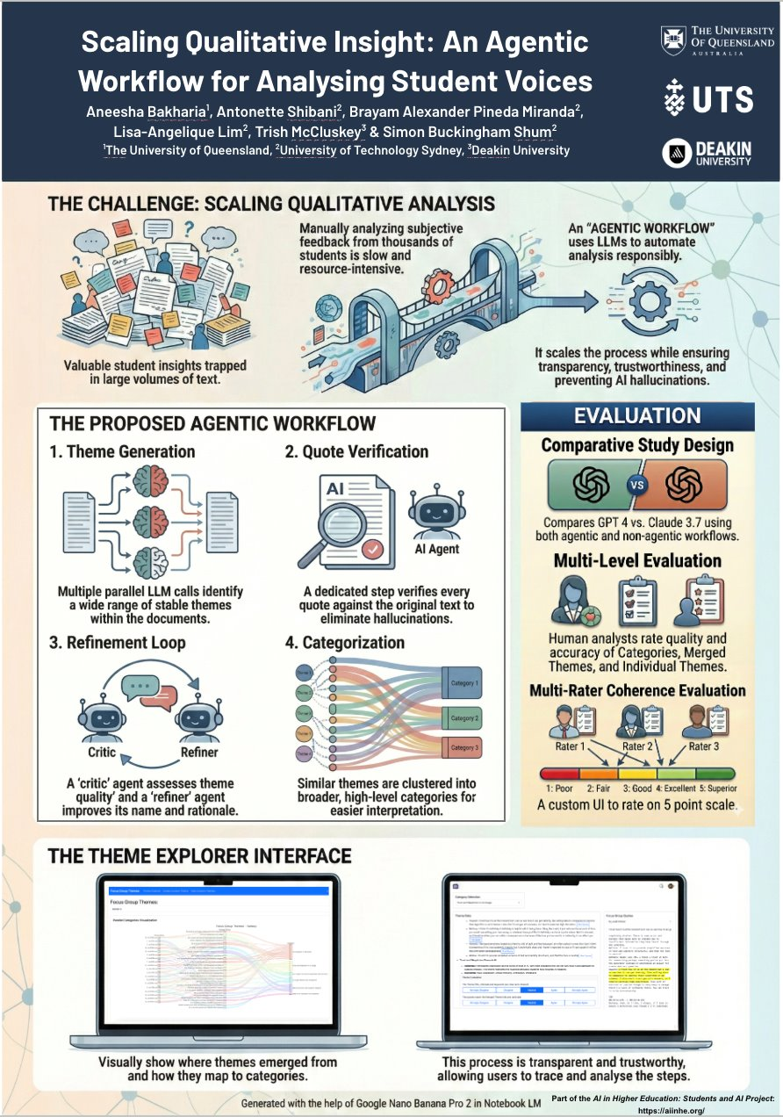
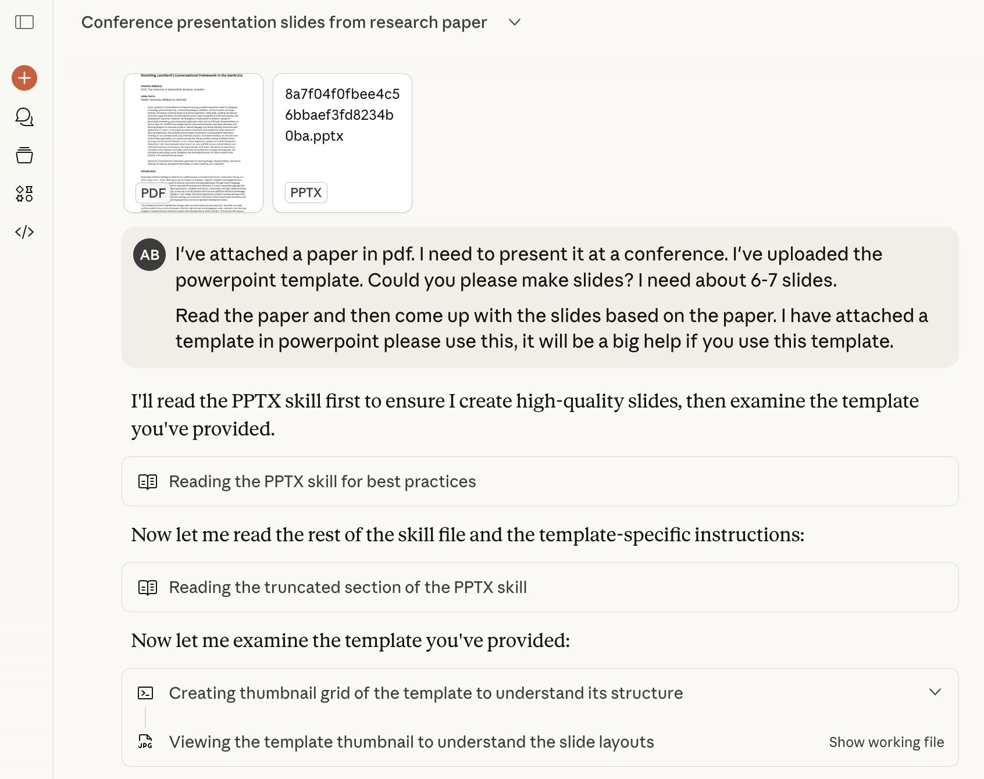
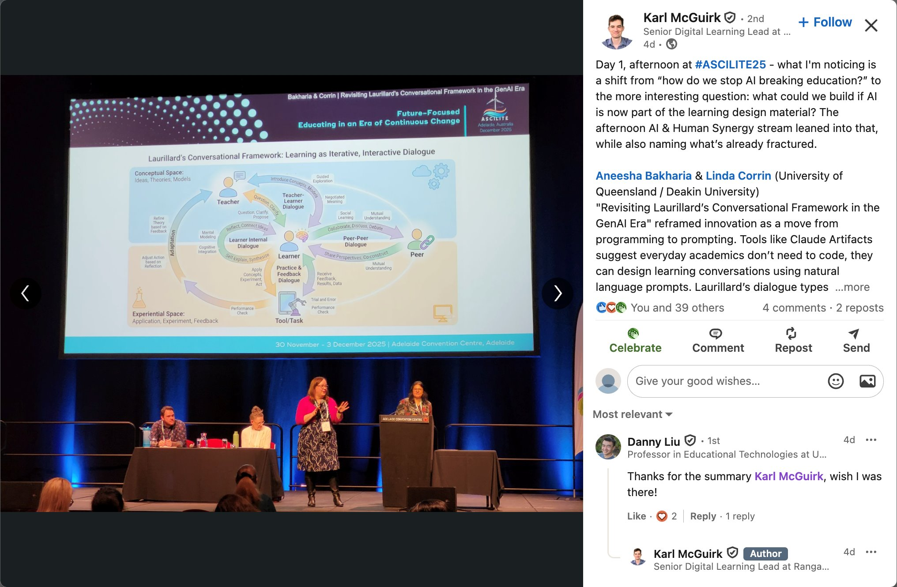
Example 6: Slides, Posters and Infographics
Slidedeck made with a
ppt template
in Anthropic Claude
Infographic Made with Gemini – Nano Banana Pro
Poster – made with
NotebookLM

Slide 19
Challenges

Slide 20
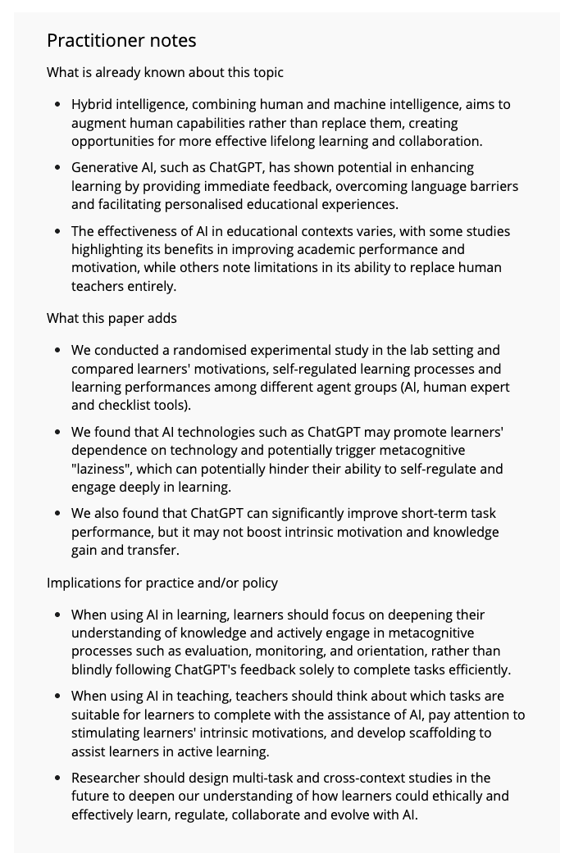
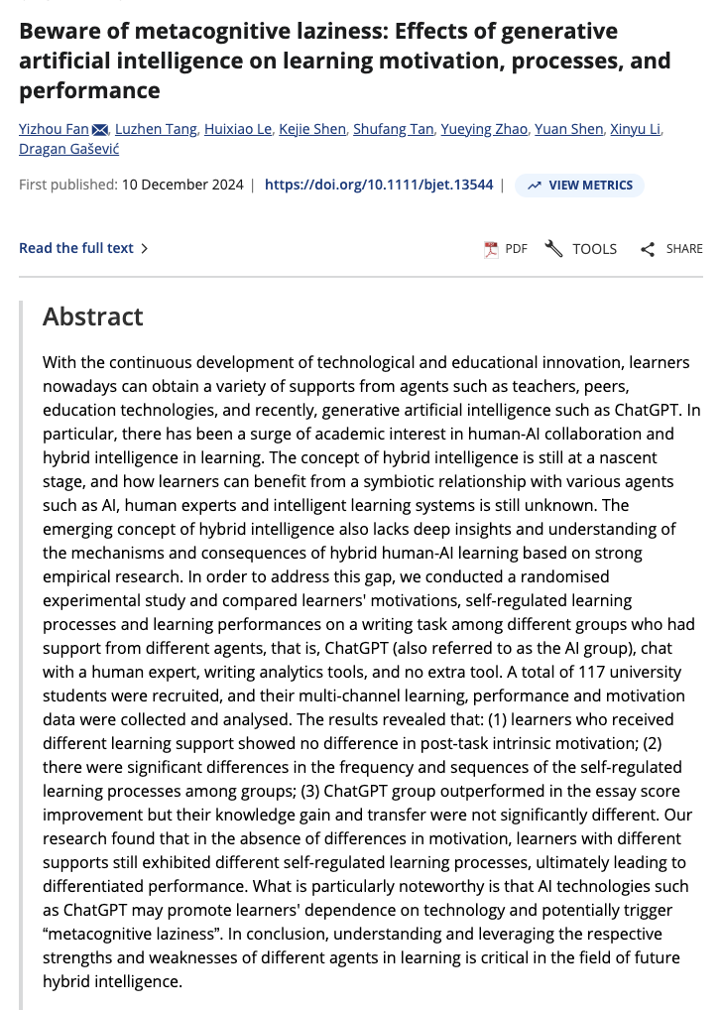
Metacognitive Laziness
https://bera-journals.onlinelibrary.wiley.com/doi/10.1111/bjet.13544

Slide 21
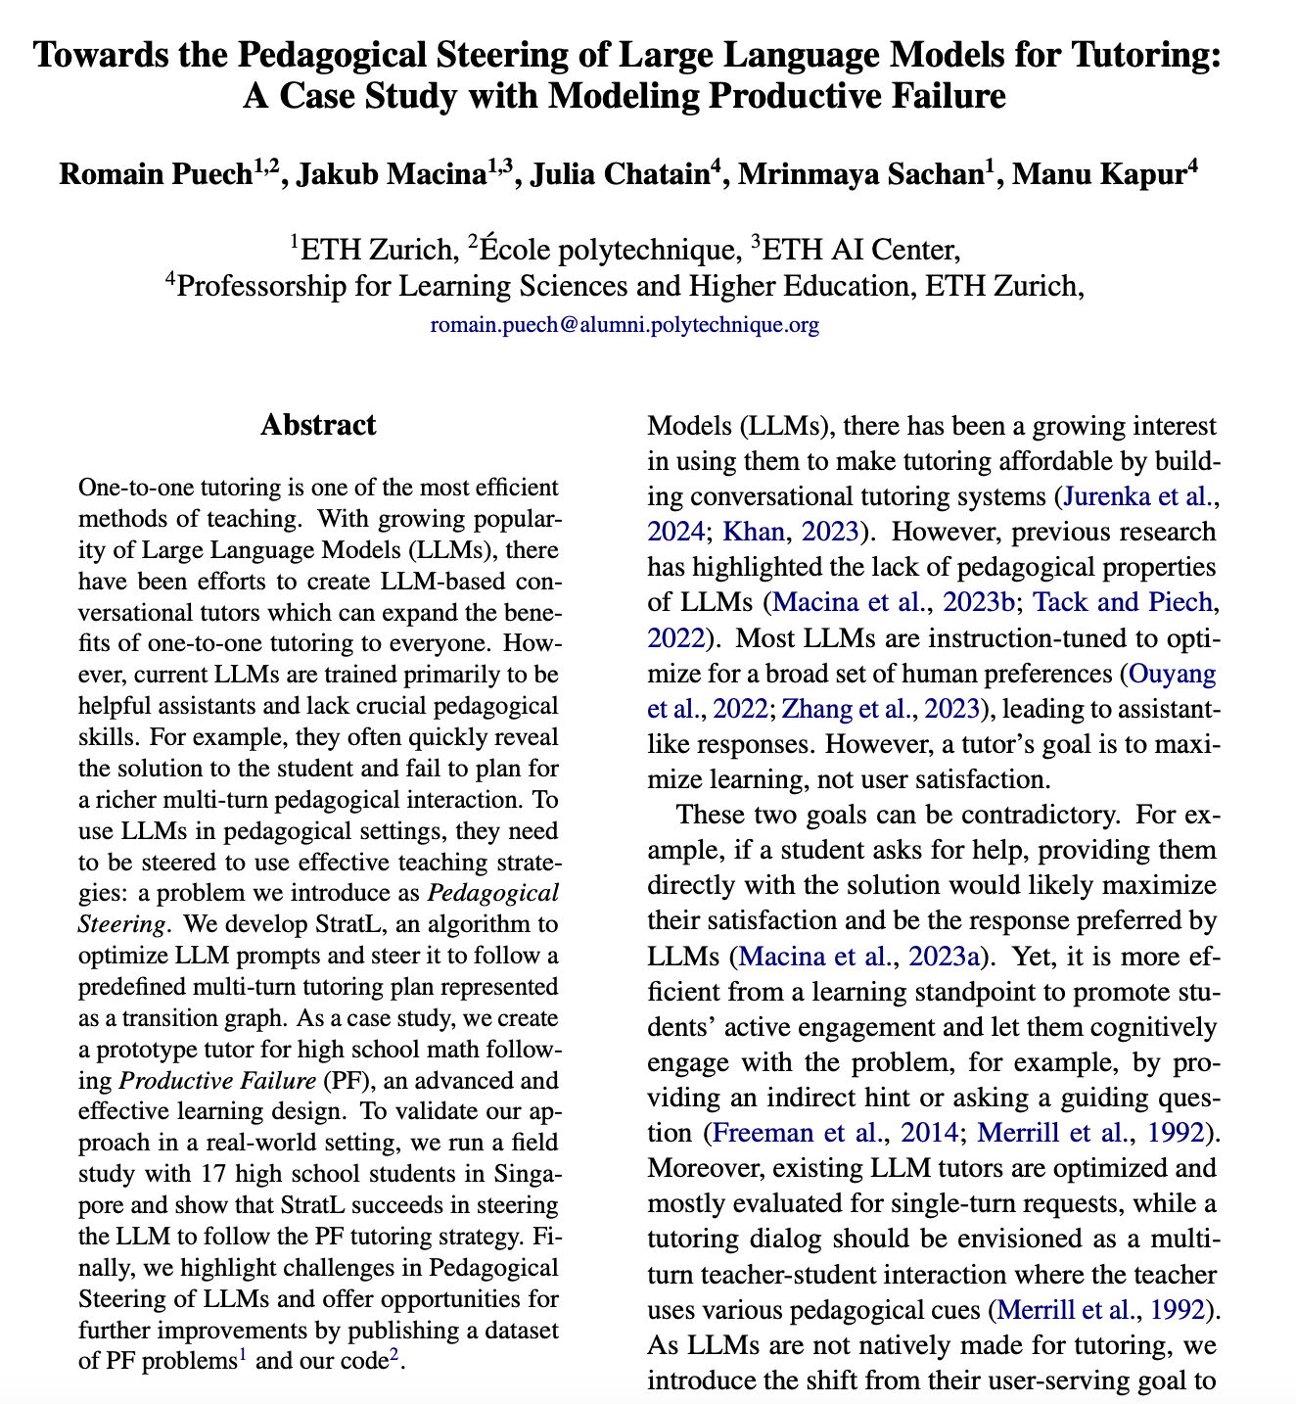
Productive Failure – The missing element?
https://aclanthology.org/2025.findings-acl.1348.pdf

Slide 22
Choose Your Adventure

Slide 23
Choose Your Adventure Labs
Lab 1: Learning Resources | Lab 2: Chatbot Tutors | Lab 3: Building GenAI Systems
Create Worksheets with Teacher Step by Step Solutions | Create a Pedagogical Moves Tutor | Teaching Students to Build Apps that Make LLM API calls
Build an Interactive Glossary | Create a Design Thinking/Brainstorming Tutor | Build your own UI for a chatbot
Developing Student Evaluative Judgement | Create a Programming Tutor that helps build debugging and code reading skills | Explore LLMs and Machine Learning Models that run in the Browser
Go to: https://prompting.uqcloud.net

Slide 24
Considerations

Slide 25
Considerations
Student Learning of Fundamentals?
Learning to Learn (even with direct answers)
Equal Access
Guiderails (for both prompts and responses)
Bias
Ethical Use
Privacy
Hallucination

Slide 26
AI Literacy

Slide 27
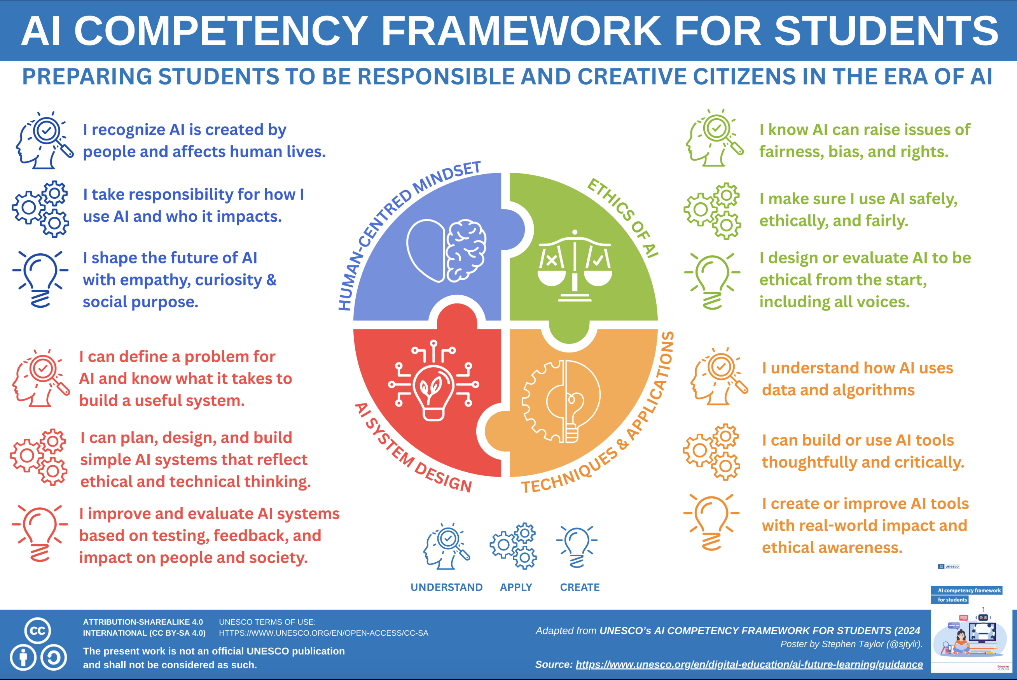

Slide 28
Thank you

